Slide 1

PROJECT H.M.K.
Intelligent AI Voice Assistant Designed to understand human speech, process it using advanced AI models, and respond naturally.
Created by: Harshit Raizada | Madhav Gaba | Kabir Khurana

Slide 2


UNLOCKING NATURAL INTERACTION WITH VOICE ASSISTANTS
HOW IT WORKS
THE REVOLUTION
Leading examples such as Siri, Alexa, and Google Assistant leverage artificial intelligence, machine learning, and speech processing to understand and respond in real time. This technology converts spoken language into commands processed by AI.
Voice assistants revolutionize technology use by enabling natural communication through voice commands instead of typing or tapping. They transform voice commands into seamless responses.

Slide 3




THE COMPLETE PROCESS FLOW
USER SPEECH
SPEECH-TO-TEXT
AI PROCESSING
TEXT-TO-SPEECH
User speaks; voice data is captured for processing.
Voice data is digitized and converted into text.
AI analyzes intent and generates a text response via API.
Response is converted back to voice and played.

Slide 4



SPEECH TO AUDIO PROCESS ARCHITECTURE
SPEECH INPUT
STT / ASR
NLP / LLM
TTS OUTPUT
Raw Audio Capture
• Acoustic Models
• NLU (Intent Extraction)
• Text Normalization
• Language Models
• NLG (Response Gen)
• Phoneme Mapping
• End-to-End Transformers
• GPT-4, Gemini, LLAMA
• Prosody & Vocoder (VITS)

Slide 5



LITERATURE REVIEW
1. SPEECH-TO-TEXT (STT)
2. NLP / LLMS
3. TEXT-TO-SPEECH (TTS)
Evolution: Shift to End-to-End Neural Architectures (CTC, RNN-T).
Evolution: Rule-based systems → Generative AI.
Evolution: Concatenative → Neural TTS (VITS).
Key Tech: Transformers + Massive Language Models.
Key Tech: GPT-4, Gemini (Context Awareness).
Key Tech: Prosody Modeling for emotion.
Challenge: Handling accent variability & real-time latency.
Capability: Intent recognition & sentiment analysis.
Metric: MOS (Mean Opinion Score) for naturalness.

Slide 6


CAPTURING SPEECH INPUT: SOUND TO SIGNAL
1. Audio Capture: Microphone captures analog voice input.
2. Signal Digitization: Analog-to-Digital Converter (ADC) creates processable binary data.
3. Signal Cleaning: Noise reduction algorithms filter background audio to isolate the voice.
4. Wake Word Activation: Low-power monitoring for keywords (e.g., "Hey Assistant") triggers the main pipeline.

Slide 7
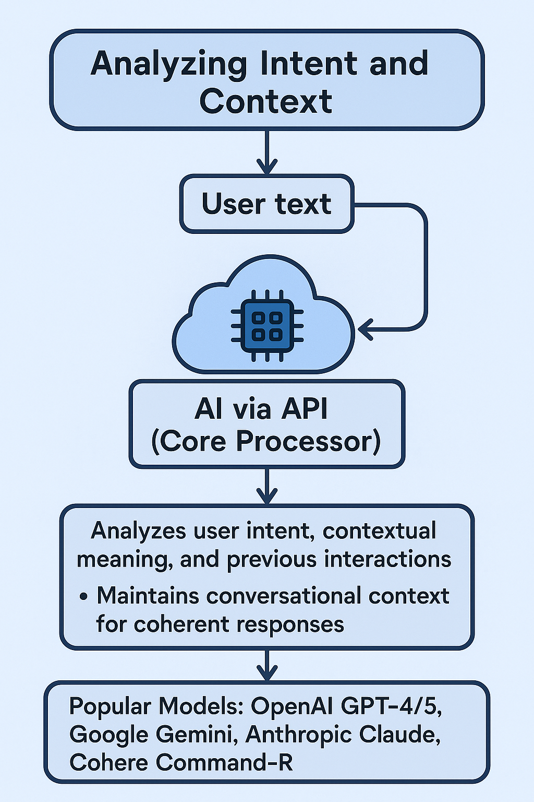
AI MODEL PROCESSING & RESPONSE
ANALYZING INTENT AND CONTEXT
Converts and sends user text to AI via API (Core Processor).
Analyzes user intent, contextual meaning, and previous interactions.
Maintains conversational context for coherent responses.
Popular Models: OpenAI GPT-4/5, Google Gemini, Anthropic Claude, Cohere Command-R.

Slide 8


UNDERSTANDING AND RESPONDING (NLU VS NLG)
NATURAL LANGUAGE GENERATION (NLG)
NATURAL LANGUAGE UNDERSTANDING (NLU)
Creates coherent, context-aware responses in natural, human-like language.
Interprets user intent by detecting keywords, tone, and sentiment. It breaks down *what* the user wants.
Example: "It's 28°C and sunny..."

Slide 9


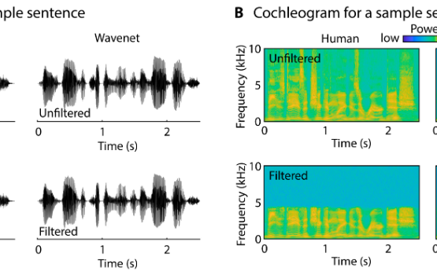
TRANSFORMING TEXT INTO NATURAL SPEECH
Text Analysis & Normalization
Preparing AI-generated text by refining structure and context for accurate synthesis.
Phoneme Mapping
Converting written text into phonemes, the fundamental units of sound.
Prosody Generation
Adding natural rhythm, tone, and emotion to produce realistic speech patterns.

Slide 10






OUTPUT, CUSTOMIZATION & LEARNING
PLAYBACK
CUSTOMIZATION
ADAPTIVE LEARNING
Synthesized speech plays through speakers or headphones, completing the interaction cycle.
Users can adjust gender, accent, tone, and even use celebrity voices.
Refines voice responses using user feedback to enhance naturalness.

Slide 11

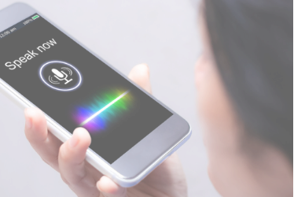
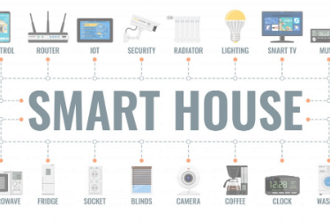




REAL-WORLD IMPACT OF VOICE ASSISTANTS
SMARTPHONES
SMART HOMES
HEALTHCARE
Siri, Google Assistant for hands-free operation.
Alexa controlling lights, thermostats, and automation.
Voice reminders for elderly and visually impaired.

Slide 12
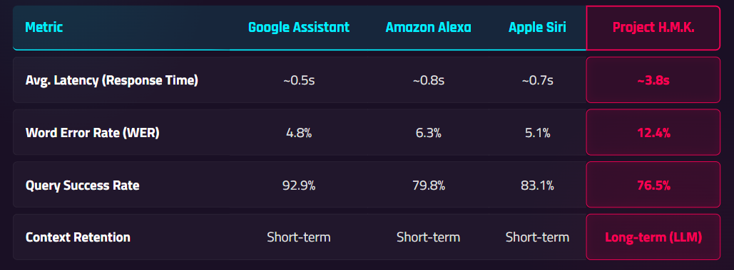

PERFORMANCE BENCHMARKING: H.M.K. VS GIANTS
A comparative analysis of Project H.M.K. against industry leaders. The results highlight the Latency vs. Intelligence trade-off inherent in cloud-chained architectures versus on-device optimization.
Key Insight: Our latency is significantly higher (3.8s) due to the lack of dedicated edge-computing hardware. However, this allows us to leverage larger, more complex LLMs in the cloud for deeper reasoning capabilities.

Slide 13

ADVANTAGES AND FUTURE POSSIBILITIES
Personalized Voice Cloning
Hands-free Interaction
AI voices cloned from user samples for unique experience.
Natural user interaction for greater convenience.
Multilingual Support
IoT Integration
Real-time translation breaking language barriers.
Seamless connection with smart home devices.
Emotion Awareness
Offline AI
Detecting feelings for personalized interactions.
Enhanced privacy and faster processing without internet.

Slide 14


BRIDGING EMOTION AND AI
AI voice assistants integrate speech recognition, language understanding, and voice synthesis to connect human emotion with machine logic. Their evolution highlights significant advances in artificial intelligence, enabling fluid and natural communication.

Slide 15

CONCLUSION
Project H.M.K. demonstrates the power of integrating advanced Cloud AI with voice interfaces. While current architectural limitations introduce latency, the depth of understanding and contextual awareness surpasses traditional command-based assistants.
The future lies in optimizing this balance—bringing LLM intelligence to the edge for real-time, emotional, and truly intelligent interaction.

Slide 16







IMAGE SOURCES
https://static.vecteezy.com/system/resources/previews/068/226/851/non_2x/dark-gray-rounded-digital-audio-waveform-visualizing-sound-frequency-with-vertical-bars-and-small-dots-on-white-background-representing-audio-signal-processing-music-editing-and-sound-design-vector.jpg
Source: www.vecteezy.com
https://theaisummer.com/static/dc1990cd6e885f6ae46a960e6f54b4fa/ee604/speech-recognition.png
Source: theaisummer.com
https://www.devoteam.com/wp-content/uploads/2024/11/architecture-api-management-devoteam-tt-width-975-height-1221-fill-0-crop-0-bgcolor-eeeeee-except_gif-1.jpg
Source: www.devoteam.com
https://pub.mdpi-res.com/audiolres/audiolres-15-00014/article_deploy/html/images/audiolres-15-00014-g001.png?1739155803
Source: www.mdpi.com
https://fedtechmagazine.com/sites/fedtechmagazine.com/files/styles/cdw_hero/public/articles/%5Bcdw_tech_site%3Afield_site_shortname%5D/201901/FedTech-ITFuturistQ1.jpg?itok=hbocMWwL
Source: fedtechmagazine.com
https://www.aeologic.com/blog/wp-content/uploads/2023/06/2162-1024x597.jpg
Source: www.aeologic.com

Slide 17



IMAGE SOURCES
https://hospitalsmagazine.com/wp-content/uploads/2025/03/Artificial-Intelligence-in-Healthcare.jpg
Source: hospitalsmagazine.com
https://photos.peopleimages.com/picture/202303/2811291-face-abstract-and-futuristic-with-science-connection-and-networking-on-blue-backdrop.-future-human-facial-and-technology-to-connect-data-analysis-and-communication-with-artificial-intelligence-fit_400_400.jpg
Source: peopleimages.com

